Slide 1

SHEPHERD

Slide 2
Agenda
Problem statement
Highlights
Supported Features
Uniqueness
Terminology
Component diagram
Comparisons with open-source technology
How we are leveraging Kubernetes
Screenshots
Q&A
Demo

Slide 3
What this session will not include
Hands-on on Kubernetes. How to up service through kubernetes on Azure.

Slide 4
Problem statement
Build Highly Scalable Workflow Management Engine that fits for Service Oriented Architecture.

Slide 5
What it takes to release V1 cut.
Contributors : 5
Commits : 101
Months : 5

Slide 6
My Experience

Slide 7
Understand the importance of Workflow management Engine
A
Execute(A)
If(isComplete(A)) execute(B)
If(isComplete(B)) execute(C); execute(D);
B
If(isComplete(C) and isComplete(D)) execute(E);
C
D
E

Slide 8
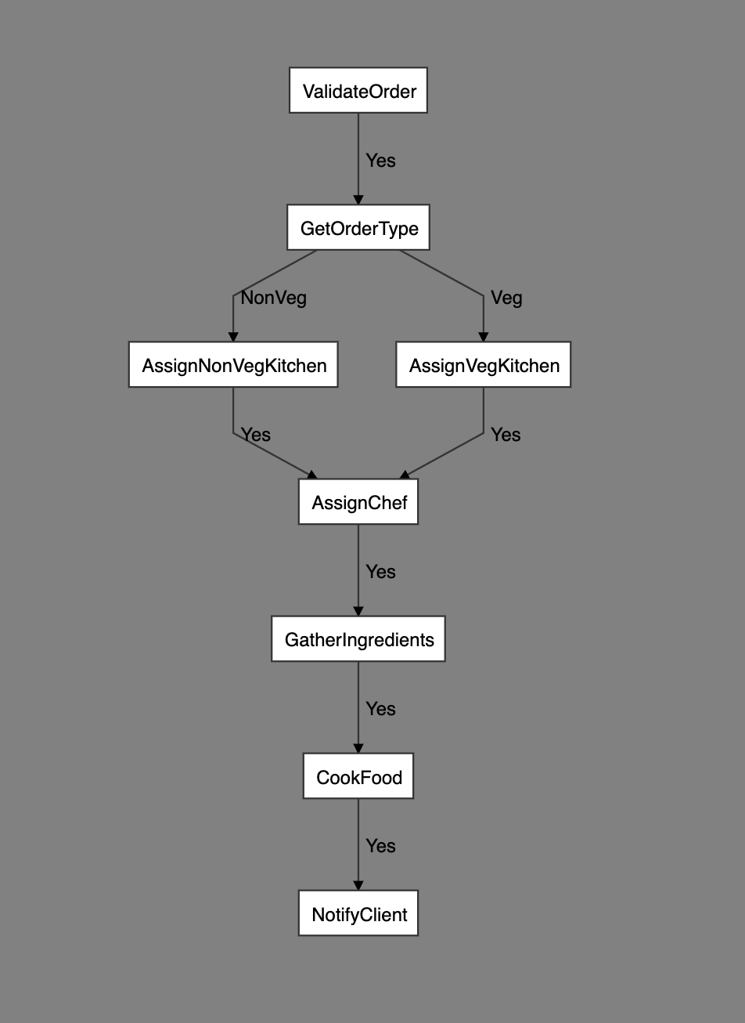

Slide 9
Supported Features
Nodes can be heterogenous in nature.
Conditional, and Unconditional workflow support.
Register clients
Add/update multiple endpoints
Execute
Resume
Restart
Kill
Retry with linear/exponential back-off

Slide 10
Uniqueness
Language agnostic.
Easy to use Dashboard.
Provides SDK in Java. Python SDK is in progress.

Slide 11
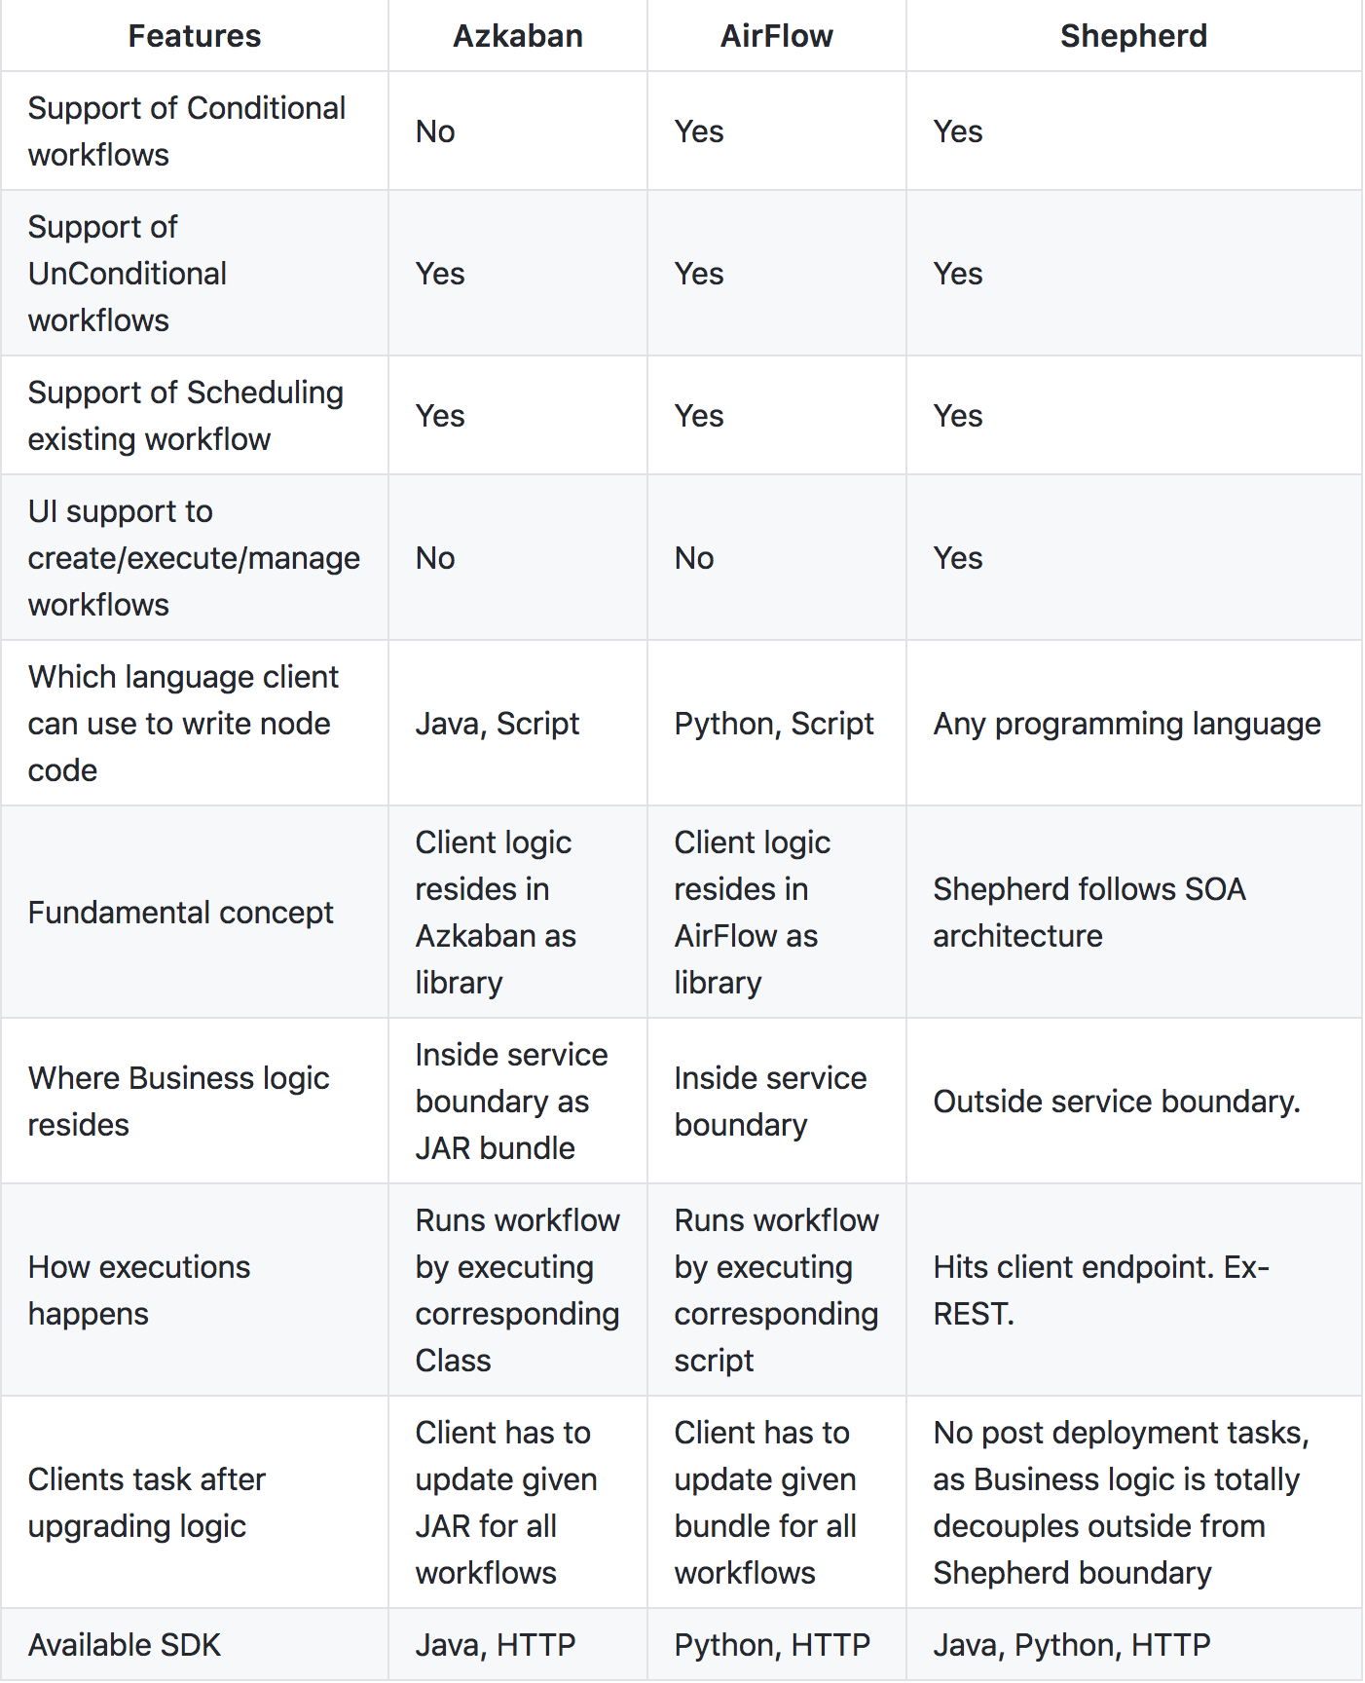
Comparisons

Slide 12
Terminology
Shepherd
Swiggy
Zomato
CLIENTS
order_beta
order_hitesh_dev
order_beta
order_prod
ENDPOINTS
exec#1
exec#2
exec#1
exec#2
EXECUTIONS
atempt#1
attempt#2
ATTEMPTS

Slide 13
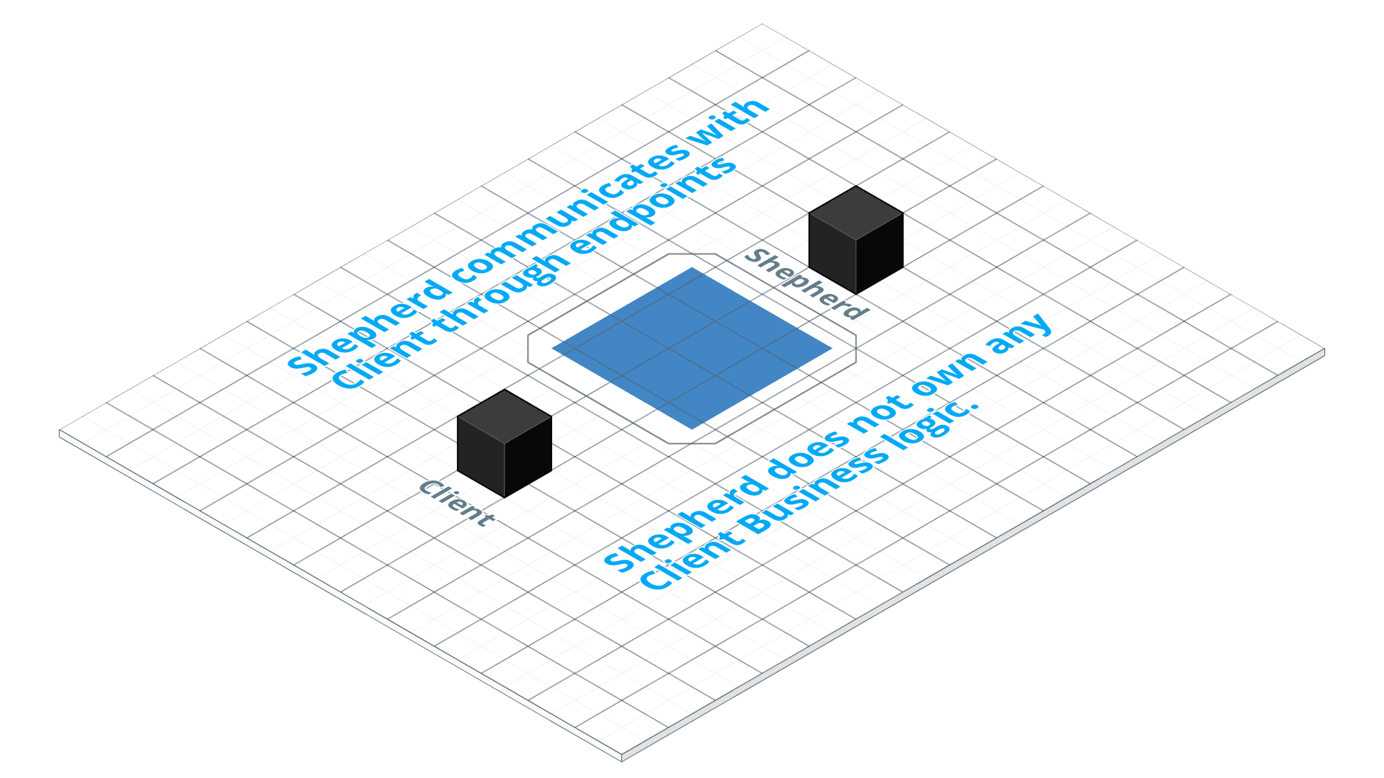
Fundamental
concept

Slide 14
Component diagram

Slide 15
Points to notice :
Shepherd’s workflow is independent of programming language. Means, Single workflow can be build with different language nodes.
Shepherd provides 2 MB space to each execution. That will be used for inter-node communication.
Workflow can be conditional and un-conditional.
Logs ownership in the hand of node owners.
If any node fails, Shepherd notifies to the right owner. It helps to drive business smoothly. [Push mechanism].

Slide 16
Client Interaction

Slide 17
Service Snapshots

Slide 18
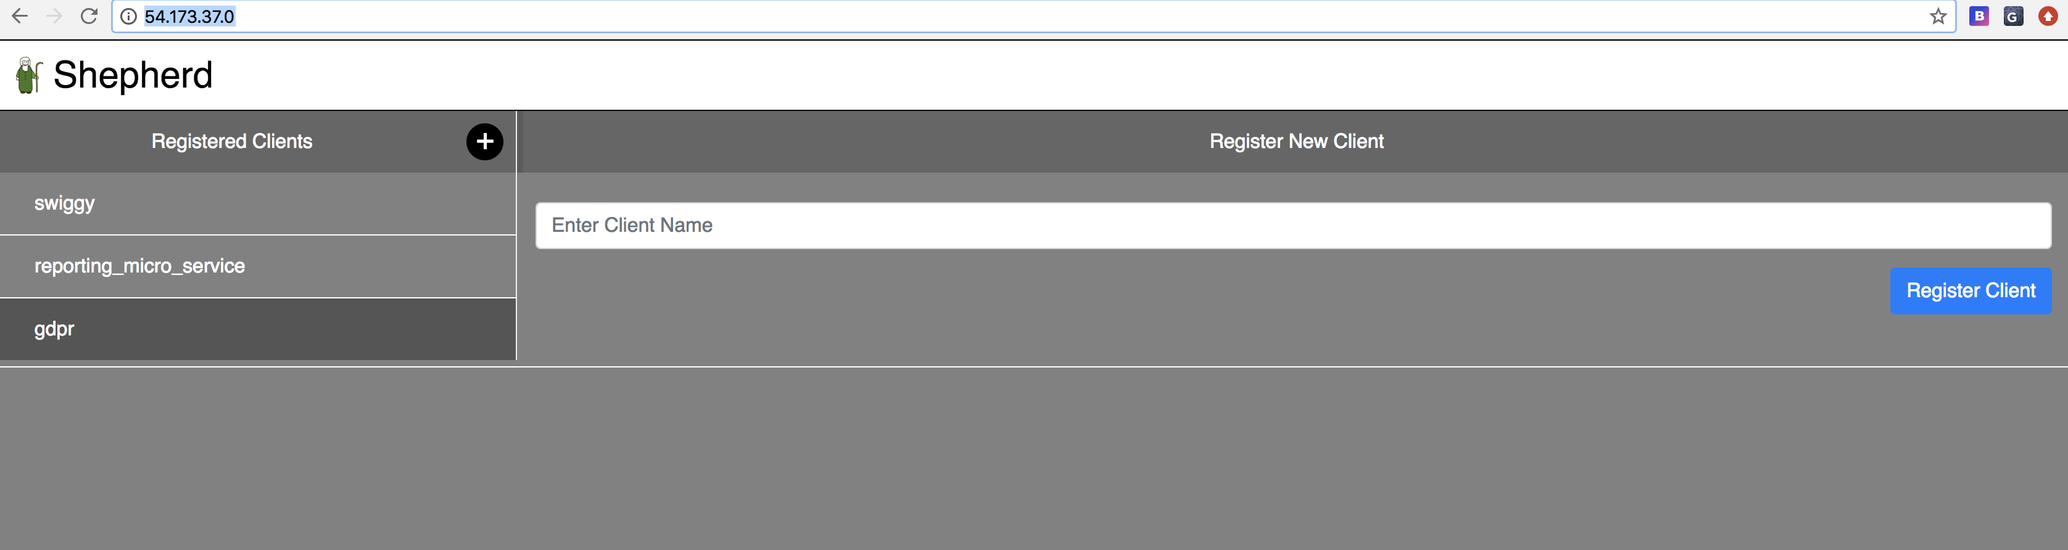
How client register himself ?

Slide 19
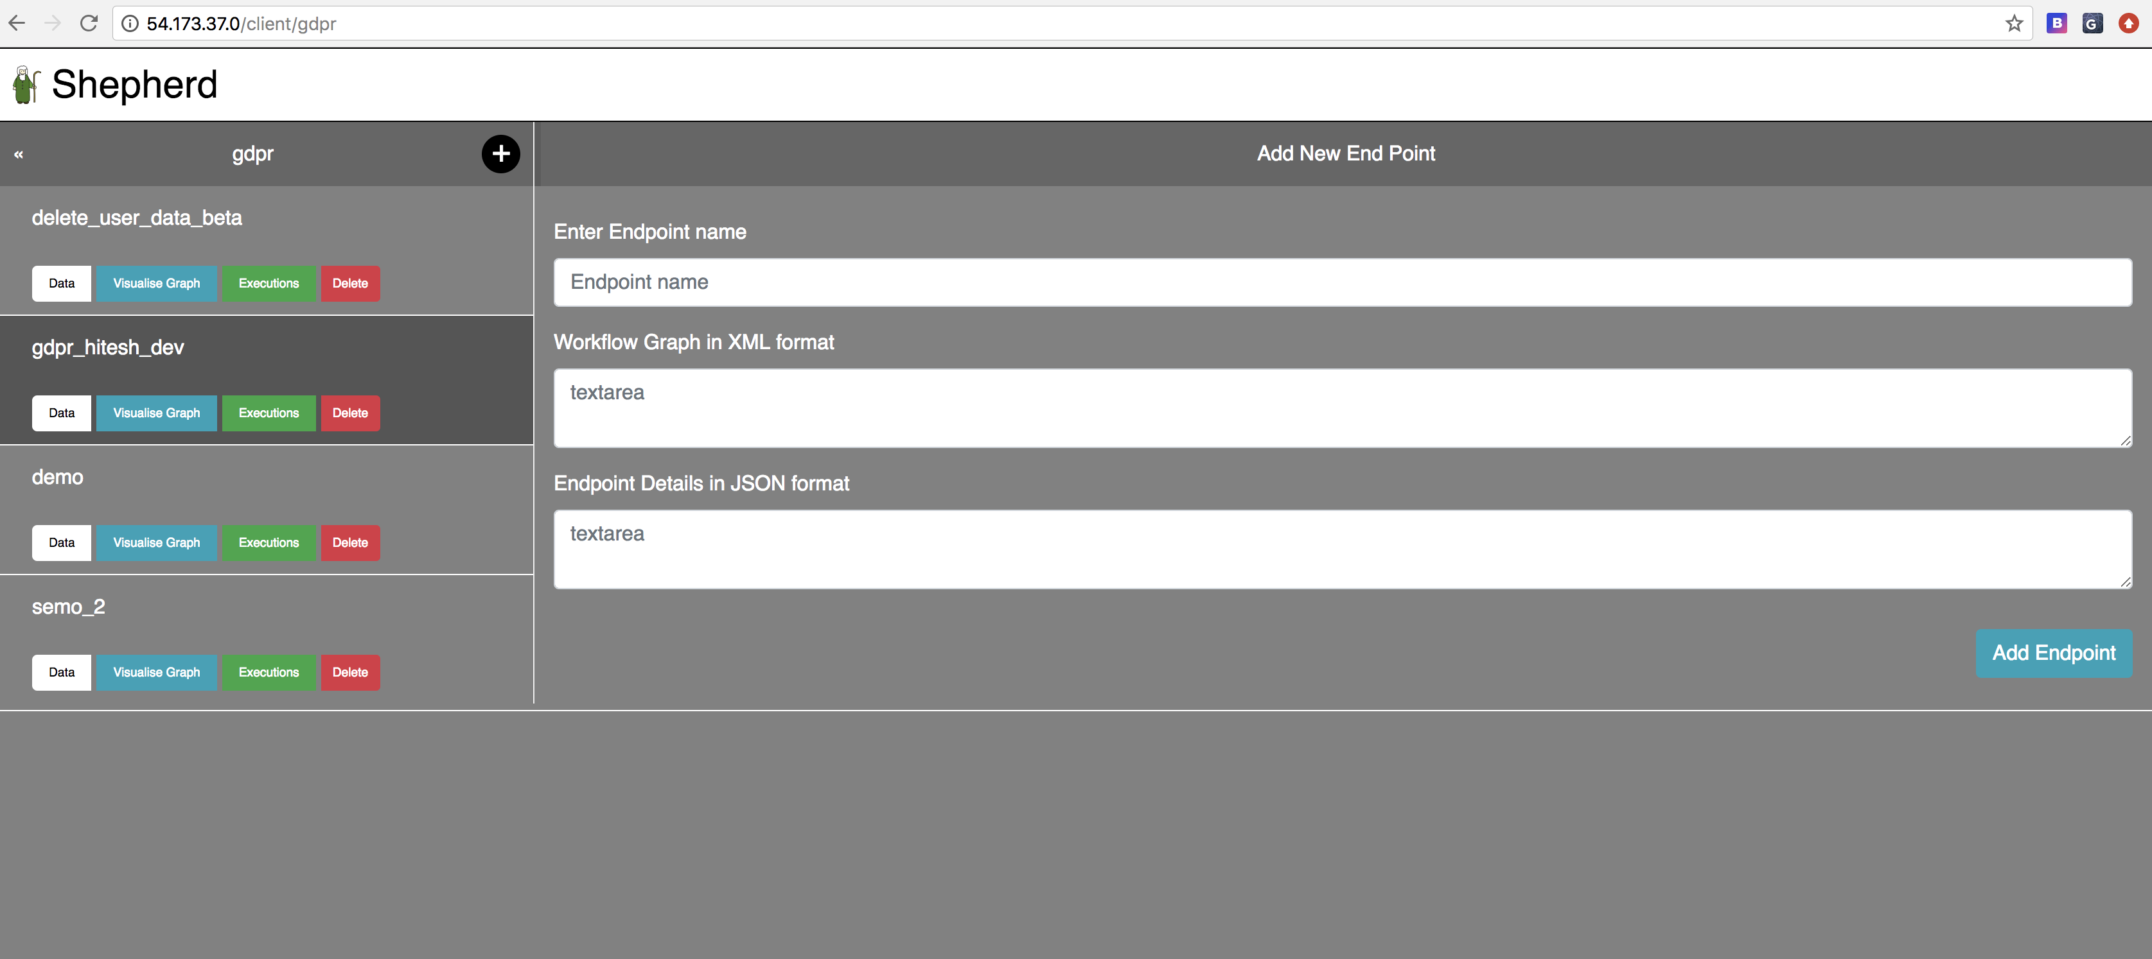
How client’s endpoint looks like ?

Slide 20
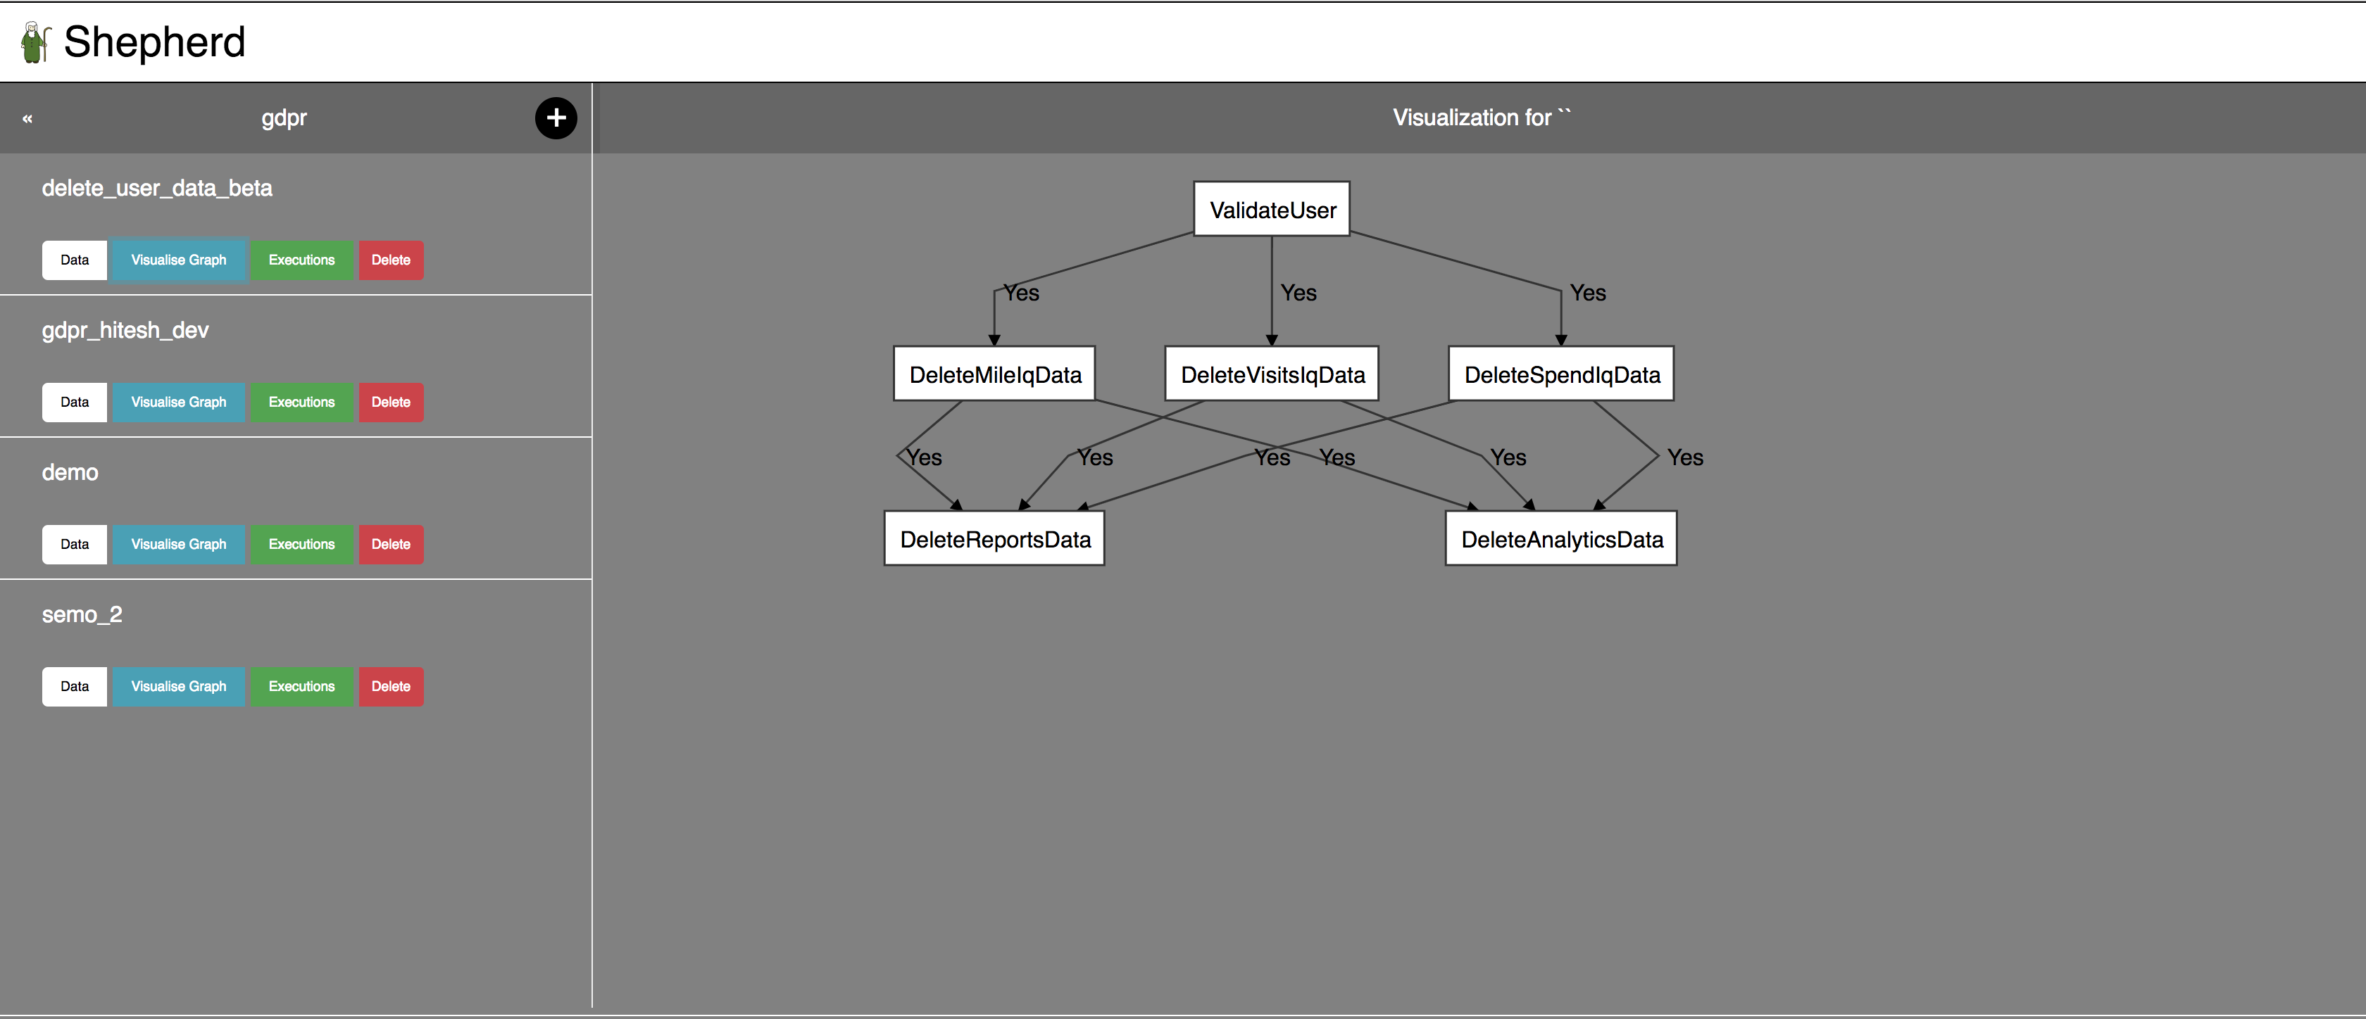
How client can visualize any endpoint ?

Slide 21
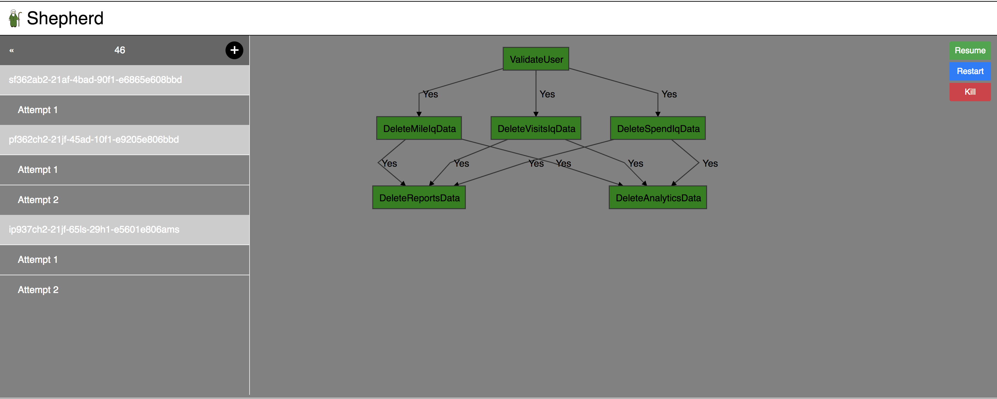
How workflow looks like when workflow completes in first attempt ?

Slide 22
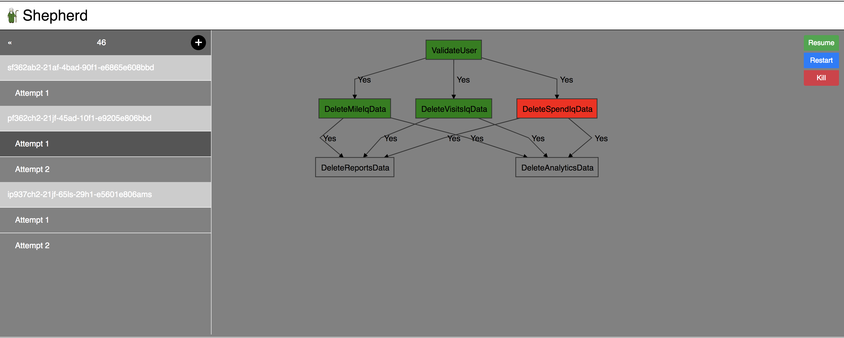

How Shepherd looks like when workflow failed at first attempt, completed in second attempt with human intervention ?

Slide 23
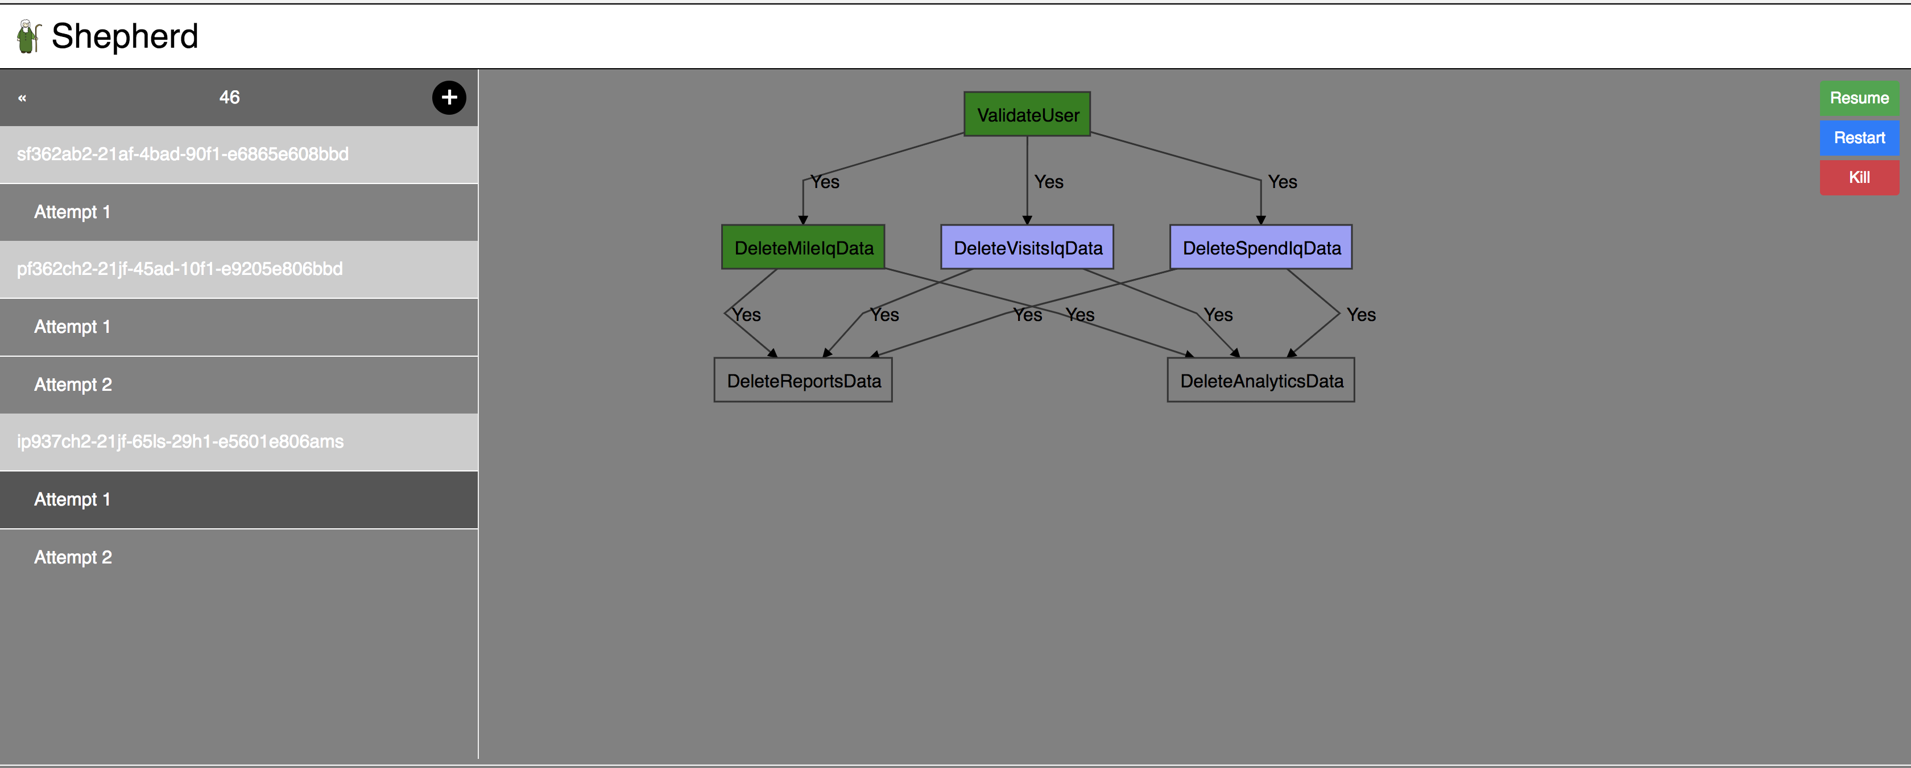
How workflow looks like when it is in processing state

Slide 24
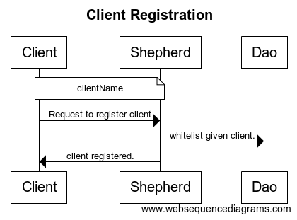
Client Registration

Slide 25
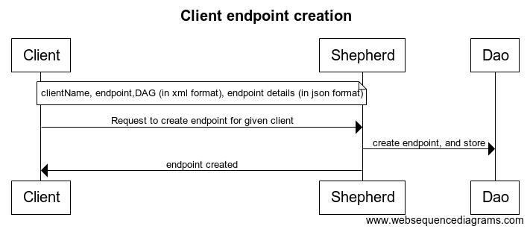
Client endpoint registration

Slide 26
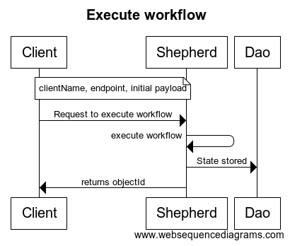
Execute workflow

Slide 27
Build pipelines
Github
VSTS
Build
VSTS
Deploy

Slide 28
High level infra
Internet user
Load balancer
Monitor
Instance#1
Instance#2
Instance#3

Slide 29
Demo

Slide 30
Questions ?

Slide 31
Thanks

